Slide 1

Department of Computer Engineering
Mini Project
Semester - VII
“AI-Powered Resume Screening System Dashboard”
Guided By: Devangi Rasikbhai Paneri
Prepared By: Riddhi Khokhariya (220002040)

Slide 2
Outline
Introduction
Project Overview
Objectives and Scope
Challenges and Solutions
Diagrams
Implementation and Roadmap
Future Plans
Conclusion
Thank You

Slide 3
Introduction
Recruitment involves screening large volumes of resumes, which is time-consuming.
Manual screening is prone to errors, inconsistencies, and bias.
Key candidate information like skills, experience, and qualifications can be overlooked.
AI and NLP can automate the extraction and analysis of resume data.
Our system parses resumes, extracts relevant details, and ranks candidates efficiently.
It reduces manual effort and speeds up the hiring process.
Enhances recruitment accuracy and helps recruiters focus on the most suitable candidates.

Slide 4
Project Overview
System Name: AI-Powered Resume Screening System Dashboard
Functionality:
Automatically extracts candidate details: Name, Email, Phone, Skills
Ranks candidates based on required skill sets
Provides interactive dashboard for visualization
Generates downloadable reports
Technology Used:
NLP, AI, Web Dashboard, Database
Programming Languages & Frameworks: Python, Flask, Bootstrap 5

Slide 5
Objectives and Scope
Objectives:
Automate resume parsing
Extract and store candidate information
Rank candidates based on job-specific skills
Provide an interactive dashboard
Scope:
Supports multiple resume formats
Dynamic skill set management by recruiters/admins
Secure storage and retrieval of resumes for future analysis

Slide 6
Challenges and Solutions
Challenges | Solutions
Parsing resumes in different formats | Implemented NLP-based parser
Ranking candidates dynamically | Skill weightage & scoring algorithm
Storing and retrieving resumes efficiently | Integrated database management
Visualizing results effectively | Interactive charts and reports on dashboard

Slide 7
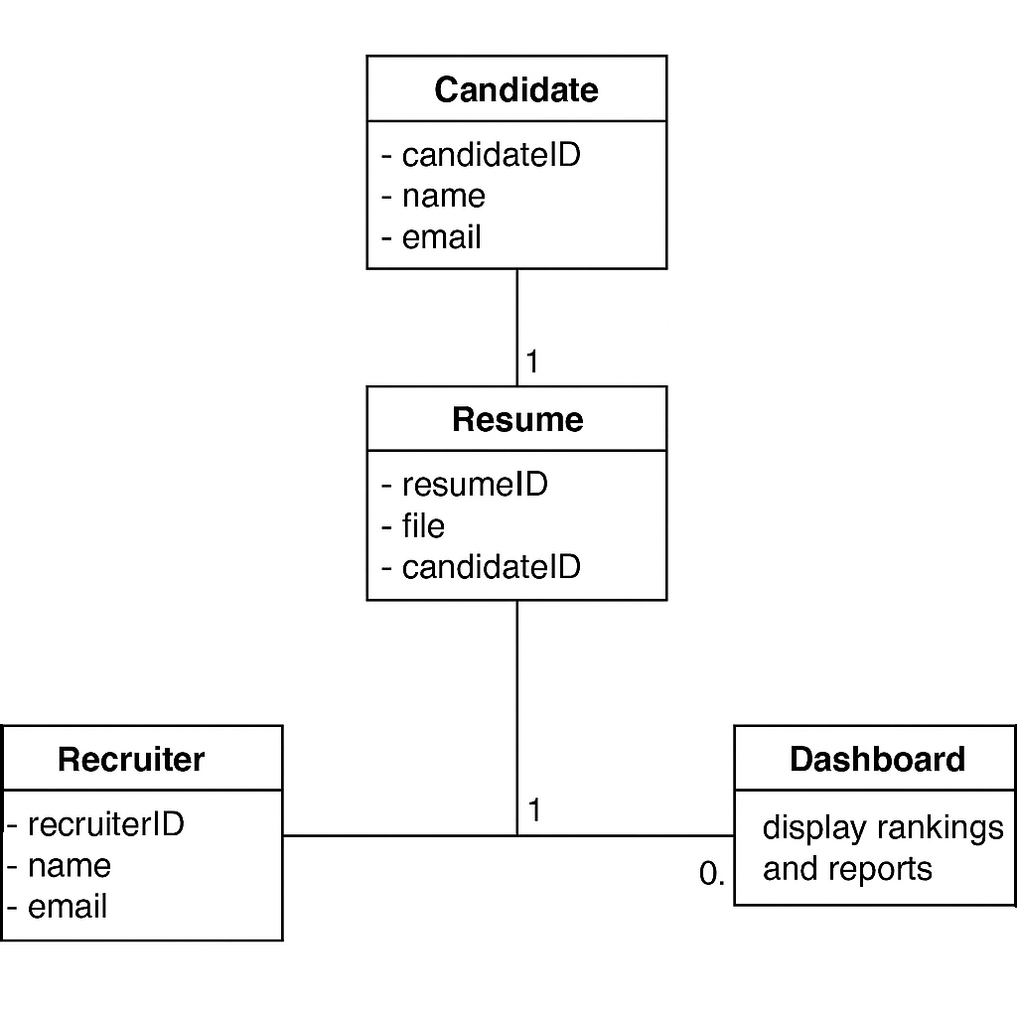
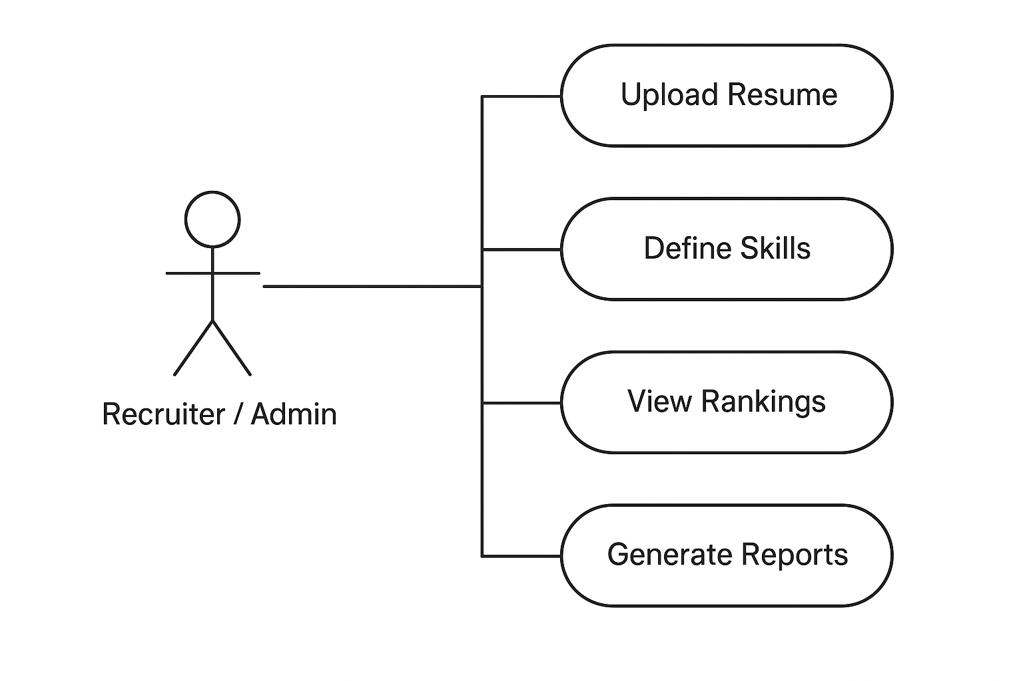
Diagrams
Class Diagram Use Case Diagram

Slide 8
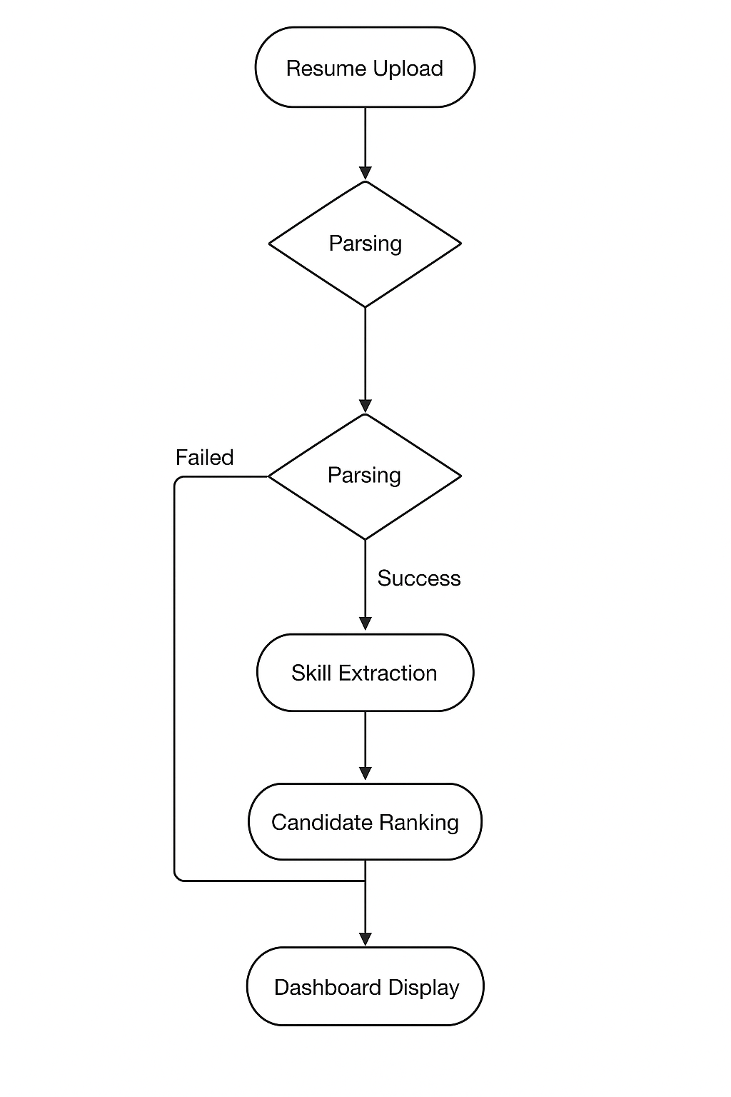
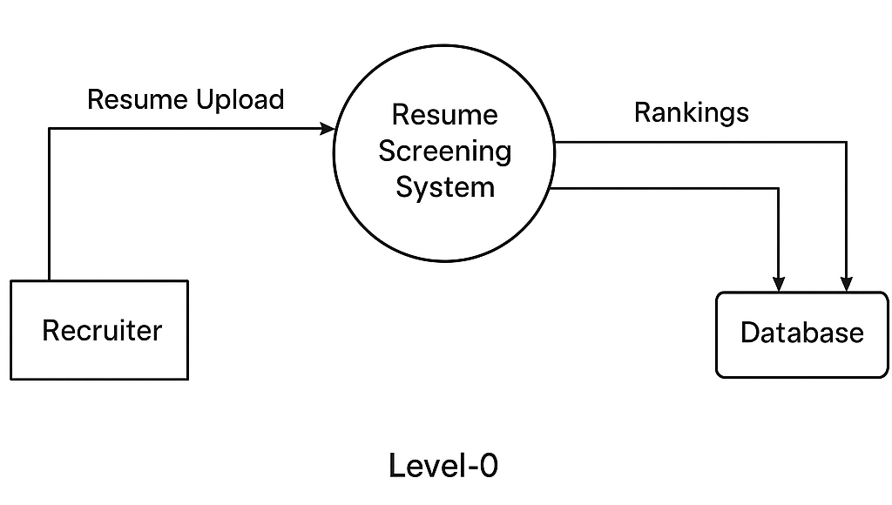
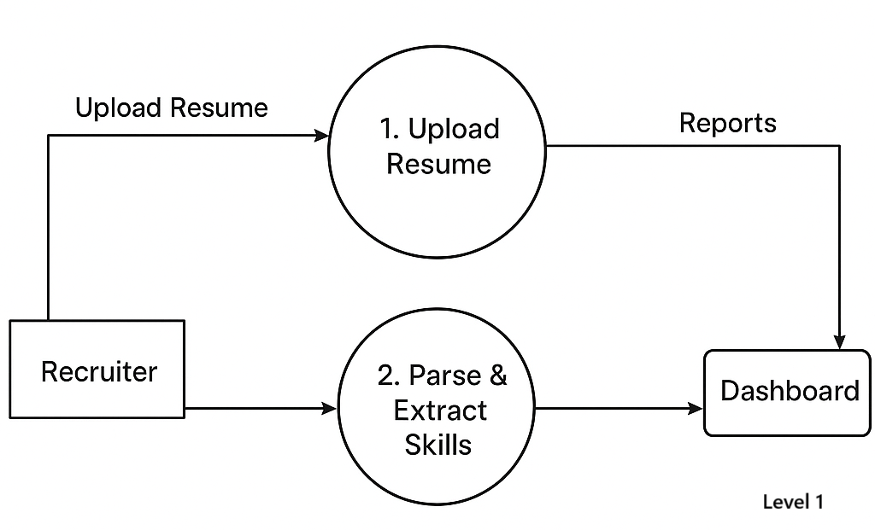
Diagrams
Activity Diagram
Data Flow Diagram

Slide 9
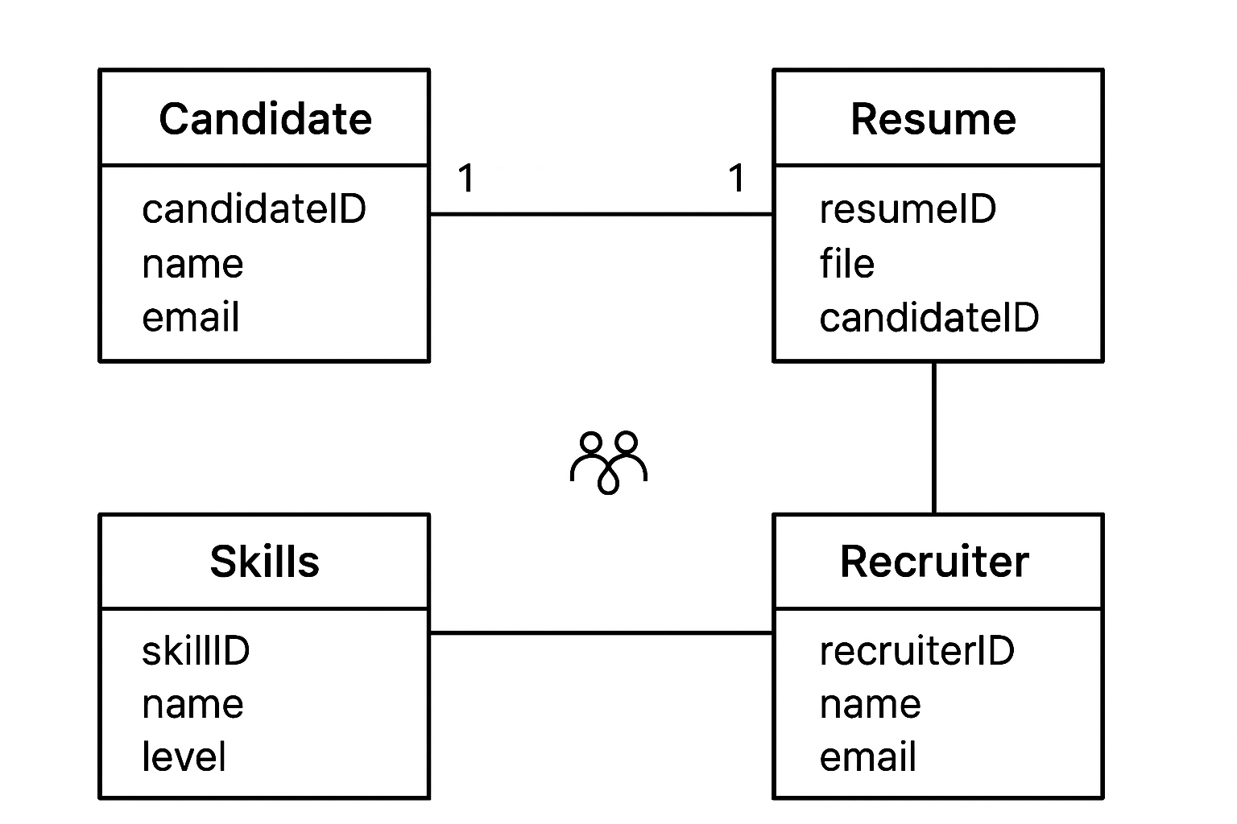
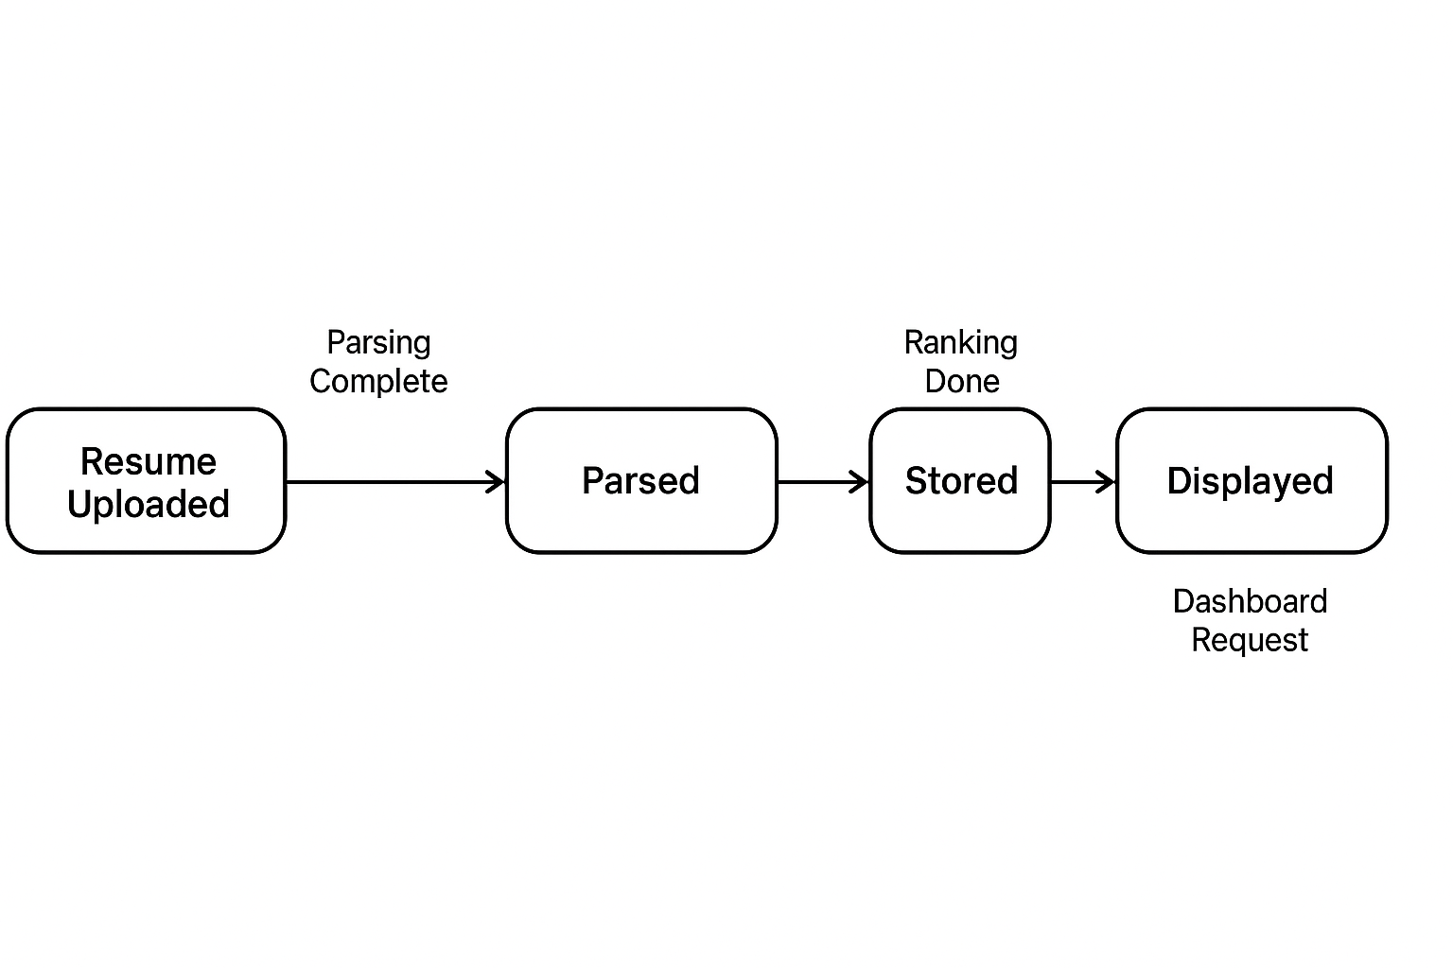
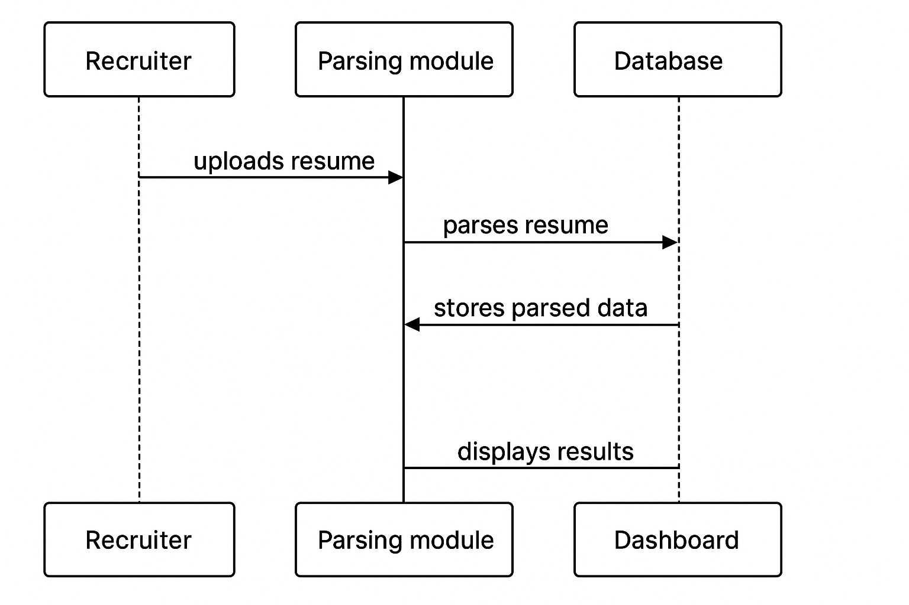
Diagrams
State Diagram
E-R Diagram
Sequence Diagram

Slide 10
Implementation and Roadmap
Implementation:
Resume Upload → Parsing → Skill Extraction → Ranking → Dashboard Display
Dashboard allows filtering, sorting, and report generation
Database stores resumes securely for tracking
Roadmap:
Phase 1: Resume Parsing & Skill Extraction
Phase 2: Candidate Ranking & Dashboard Visualization
Phase 3: Reporting & Dynamic Skill Management

Slide 11
Future Plans
Integrate AI-based predictive analytics for candidate-job fit
Support multilingual resume parsing
Enable advanced filtering using machine learning models
Improve dashboard UX with real-time analytics

Slide 12
Conclusion
AI-powered resume screening reduces manual effort and time.
Interactive dashboard provides insights for recruiters.
Dynamic skill management ensures alignment with job requirements.
Secure database integration enables efficient data handling.

Slide 13


